Slide 1
Interview Trainer Agent
CAPSTONE PROJECT
Presented By
Student name :Manga Deepak
College Name & Department :Narayana Engineering College,Nellore & CSE-AIML

Slide 2
OUTLINE
Problem Statement
Technology used
Wow factor
End users
Result
Conclusion
Git-hub Link
Future scope
IBM Certifications

Slide 3
Problem Statement
An Interview Trainer Agent, powered by RAG (Retrieval-Augmented Generation), prepares users for job interviews by generating tailored question sets and preparation strategies based on their profile name, experience level, and job role. It retrieves role-specific interview questions, industry expectations, behavioral scenarios, and HR guidelines from recruitment portals, professional networks, and company interview databases.
Proposed Solution
We propose the development of an AI-powered Interview Trainer Agent that provides interactive, personalized, and adaptive interview practice for users. The agent simulates realistic interview scenarios, evaluates user responses, and offers actionable feedback for improvement.

Slide 4
Technology used
IBM cloud lite services
Natural Language Processing (NLP)
Retrieval Augmented Generation (RAG)

Slide 5
IBM cloud services used
IBM Cloud Watsonx AI Studio
IBM Cloud Watsonx AI runtime
IBM Cloud Agent Lab
Agentic AI on IBM Cloud

Slide 6
Wow factors
1.Instant Expert-Like Responses
The chatbot provides precise, well-structured answers to common interview questions, helping users understand the ideal way to respond.
2. Wide Coverage of Question Types
Supports a wide range of interview questions: technical, HR, behavioral, role-specific, and soft skills, across multiple industries.
3. Answer Optimization Tips
After providing an answer, the chatbot also explains why it works well, and how to make it even more impactful using strategies like the STAR method or key phrasing.
4. Personalization by Role and Domain
Users can ask role-specific queries like “What’s the best answer for ‘Why should we hire you?’ for a Data Analyst?” — and get a tailored response.
5. Model Answers with Explanation
Provides model answers along with a breakdown of structure (e.g., intro, body, conclusion), teaching users how to craft their own responses.

Slide 7
End users
1.Students & Fresh Graduates
Preparing for campus placements, internships, or their first job.
Need help answering common HR and technical interview questions.
2. Job Seekers
Individuals actively applying for jobs and attending interviews.
Benefit from ready-made model answers and confidence-building tips.
3. Working Professionals
Preparing for internal promotions, performance reviews, or external opportunities.
Use the chatbot for brushing up on interview strategy and communication.
4. Placement & Career Counselors
Use the chatbot as a supplementary tool to guide students or clients.
Can refer answers from the bot during mock interviews.

Slide 8
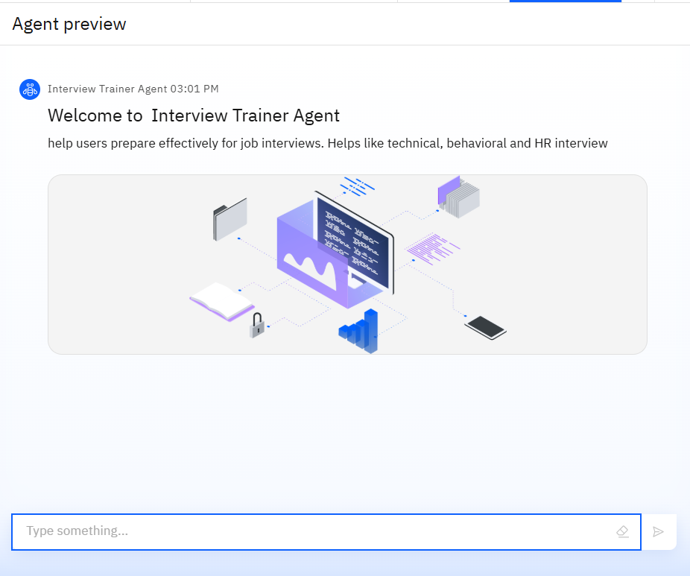
Results

Slide 9
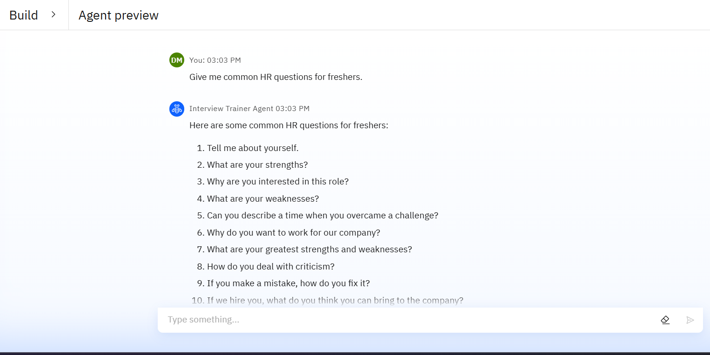
Results

Slide 10
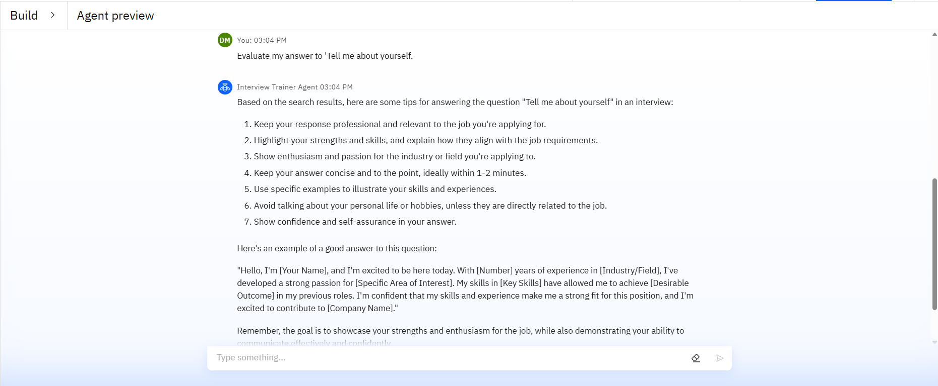
Results

Slide 11
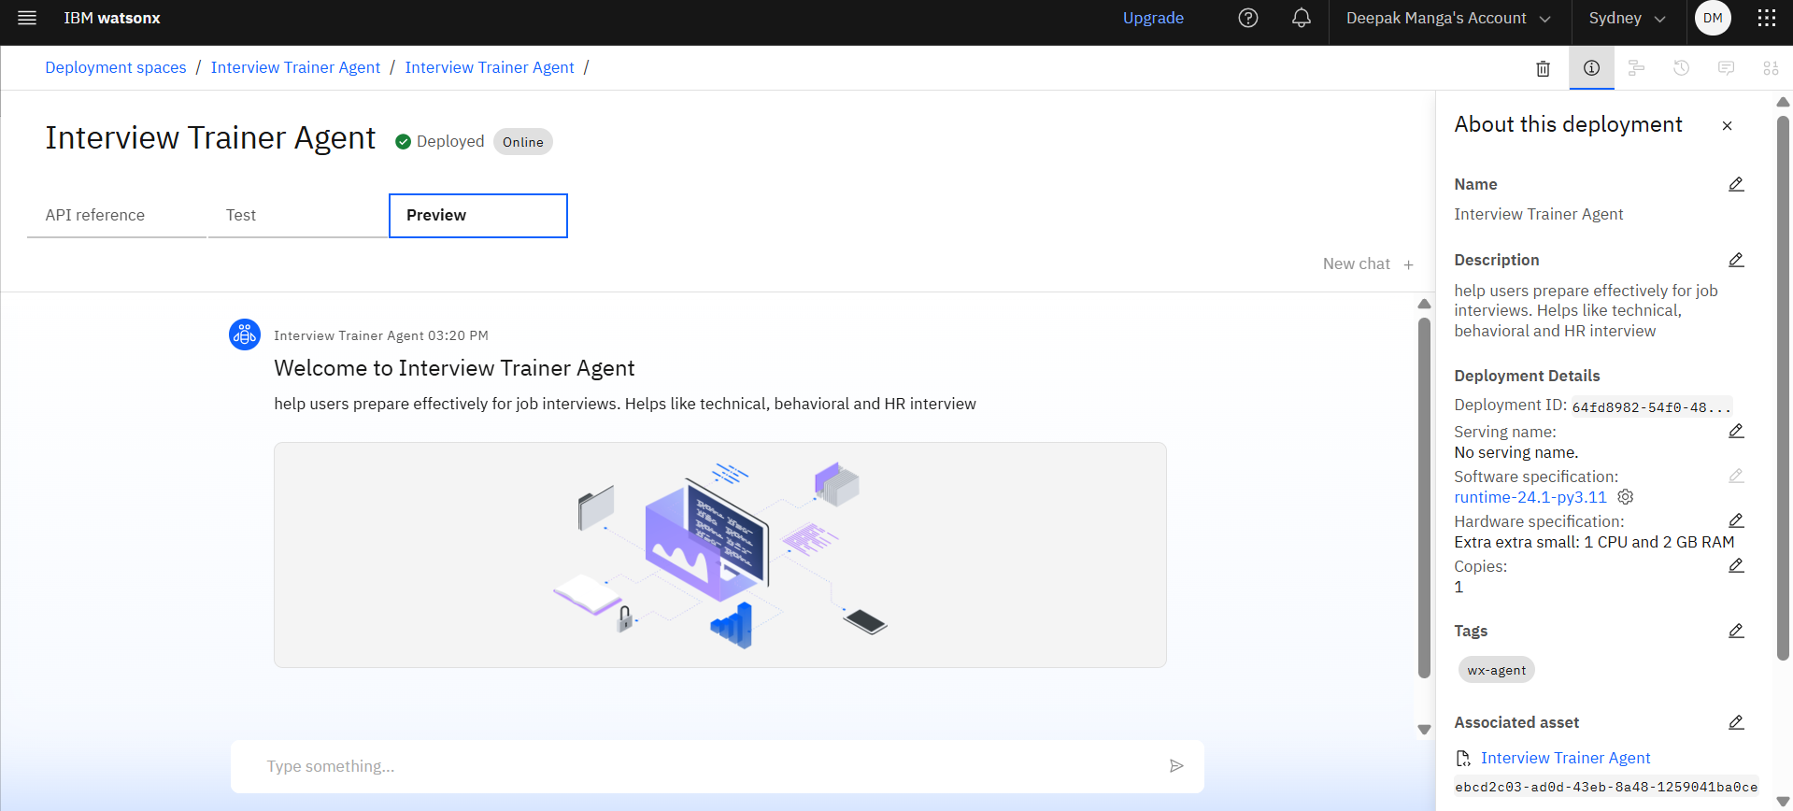
Results
Deployed AI Agent

Slide 12
Conclusion
The Interview Trainer Chatbot serves as a smart, accessible, and user-friendly solution to help individuals prepare for interviews with greater confidence and clarity. By offering instant, well-structured answers to a wide variety of interview questions, it bridges the gap between traditional preparation methods and the need for personalized, on-demand guidance.
Its domain-specific responses, answer explanations, and role-based adaptability make it a valuable tool for students, job seekers, and professionals alike. While simple in design, the chatbot delivers meaningful value by enhancing users’ communication skills and readiness for real-world interviews.
With future enhancements such as voice interaction, resume integration, or answer feedback, the chatbot has the potential to evolve into a comprehensive interview coaching platform.

Slide 13
Future scope
1. Voice and Video-Based Interaction
Integrate speech recognition for voice-based mock interviews.
Use facial expression and body language analysis (via webcam) to provide feedback on non-verbal communication.
2. AI-Based Response Evaluation
Add functionality to analyze user responses (typed or spoken) for clarity, tone, and relevance.
Provide automated scoring and improvement tips.
3. Resume-Based Question Generation
Allow users to upload their resume, enabling the chatbot to generate personalized questions and sample answers aligned with their background.
4. Role-Based Interview Flows
Expand to include complete interview simulations, with different rounds (HR, technical, managerial) tailored to specific job roles and industries.

Slide 14
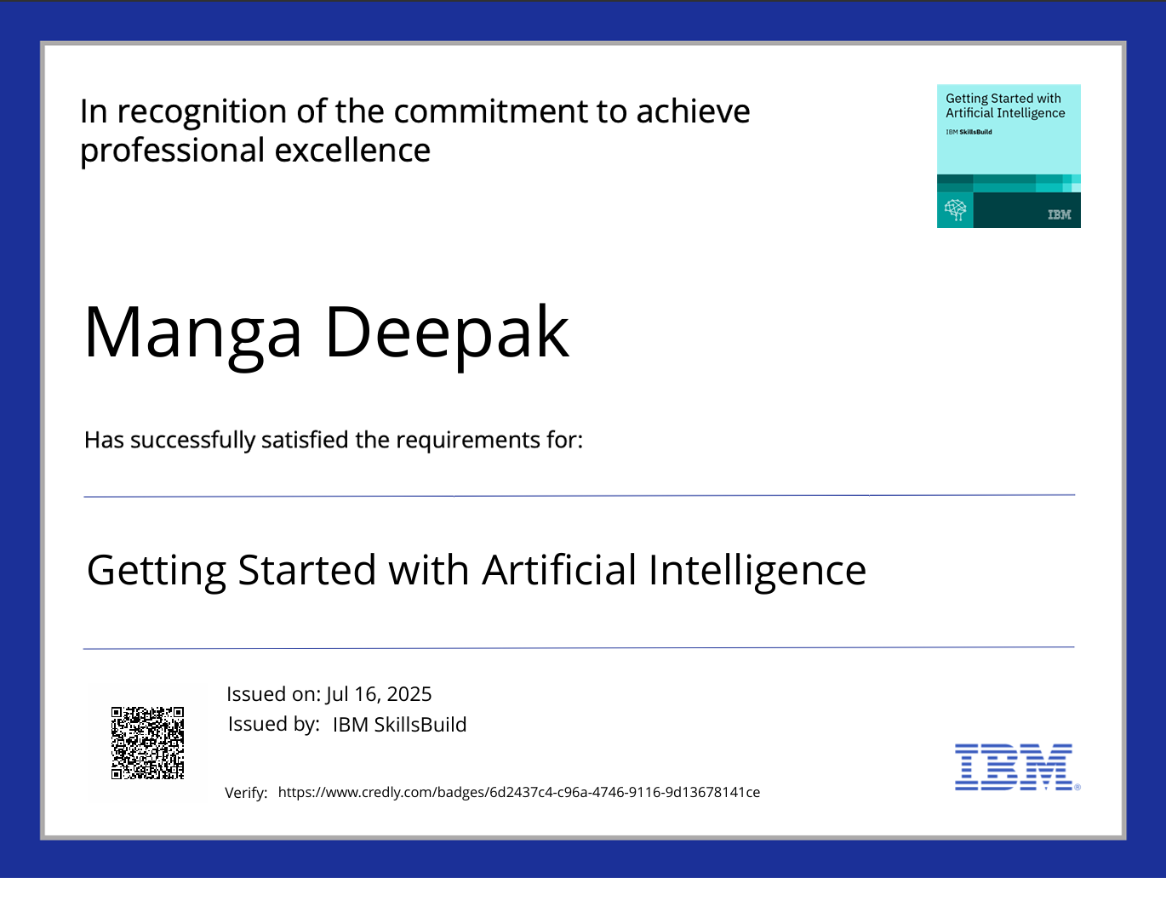
IBM Certifications

Slide 15
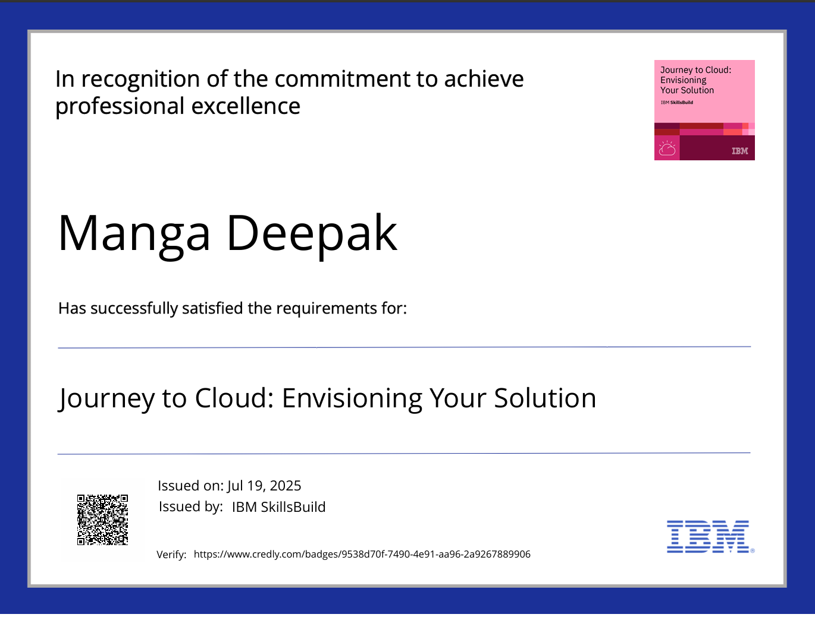
IBM Certifications

Slide 16
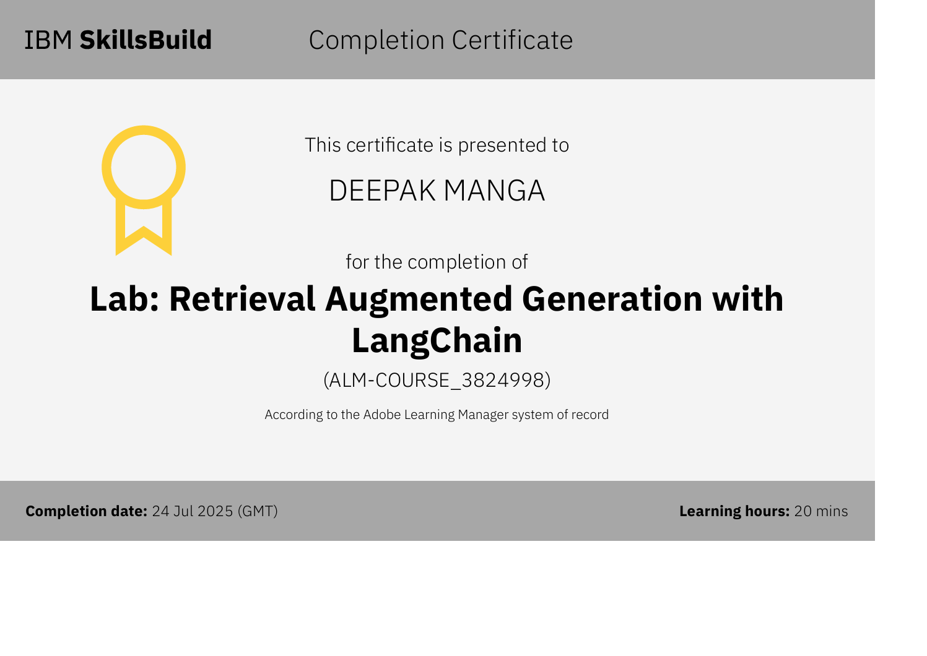

Slide 17
GitHub Link

Slide 18
THANK YOU

